Slide 1



All About the
USPC Member
Achievement Program
~ Sponsored by LeMieux ~

Slide 2


USPC Member Achievement Program
~ Sponsored by LeMieux ~
PURPOSE OF THE PROGRAM
Any active, compliant Participating Member, regardless of age or certification level, can earn points for participating in everyday USPC activities, as well as regional, national, and international events.
It encourages member participation and provides a positive experience to honor “achievement” within USPC.

Slide 3

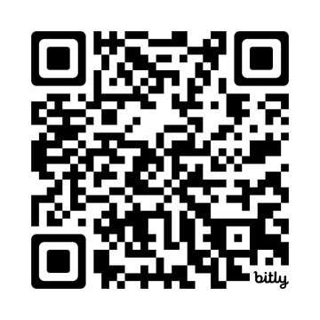



Member Achievement Program
HOW DOES IT WORK
ENROLL
EARN
SUBMIT
ACHIEVE
an entry for each date you were involved.
recognition,
and prizes, based on how active you were for the year.
anytime in the year to begin earning points.
points in each qualifying USPC activity you participate in.
Members can enroll for a nominal $30 per year at any point in the year.
The EARLIER the better.

Slide 4
Member Achievement Program
AGE DIVISIONS
Members participate within various age divisions and win awards based on national rankings and recognition pins based on an individual’s total points.
  8 and Under
  9 to 12
  13 to 15
  16 to 19
  20 to 24
  25 to 29
  30 to 49
  50 and Over
AWARDS
Members receive recognition pins at 300 points. Those who place in the Top 10 in their divisions win prizes from LeMieux during the USPC Convention.

Slide 5
HOW TO EARN POINTS
Member Achievement Program
  Points only awarded to those with an “Active Participating Member” status.
  Points are non-transferable between members, parents, and/or leaders.
  Points are ONLY earned from the sign-up date onward. So the EARLIER you sign up, the better.
  Points are claimed by the “activity” (multiple per day allowed).
  Points for “events” cannot be claimed by the day.
  Points are accumulated from January 1–December 31 of each year.
  Points are pulled out of the system on January 1 of the following year.
  Members must contact their club/region if records are missing.
  USPC reserves the right to refuse or deny points.

Slide 6
POINT-BASED ACTIVITIES
Member Achievement Program
ITEM | POINTS | NOTES
Achieve “A” Certification | 150 | Must have certification on record with the National Testing Coordinator.
Participate in International Exchanges | 100 | Includes: IMGE, IPE, Foxhunting, Quiz, Tetrathlon, Virtual Dressage, Virtual Quiz, and Virtual Show Jumping.
Participate in Festival Education | 100 | Must have entry on file with the USPC National Office.
Participate in Festival Championships | 100 | Must have entry on file with the USPC National Office.
Achieve a C-3, B, H-B, or H-A Certification | 100 | Must have certification on record with the National Testing Coordinator.
Special National Opportunity | 75 | Includes: Research Project Fair, Prince Philip Cup, USEF Pony Jumper Championships, Upper-Level Member Showcase, and the USHJA Horsemanship Challenge.
Achieve Local Certification | 75 | Includes: D-1, D-2, D-3, C-1, and C-2 certifications. Must have new certification entered in USPC system.
CHMJ/Co-CHMJ/PCHMJ at Rally or Championships | 75 | If at Festival Championships, must have record of full-time volunteer staff.
Attend Convention | 75 | Must be registered through USPC Database

Slide 7
POINT-BASED ACTIVITIES
Member Achievement Program
ITEM | POINTS | NOTES
AHMJ for a Rally or Championships | 50 | If at Festival Championships, must have record of full-time volunteer staff.
Participate in a Rally | 50
Participate in USPC Recognition Programs | 30 | Includes: Dressage, Eventing, Foxhunting.
Attend a Multi-Day Region, Center, or Club Camp | 40
Teach a clinic, at a camp, or a lesson | 20
Attend a mounted meeting, clinic, or club/center lesson | 15
Attend an unmounted meeting | 10
Volunteer for 8+ hours with your Region, Club, or Center | 10
Volunteer for 4+ hours with your Region, Club, or Center | 5

Slide 8

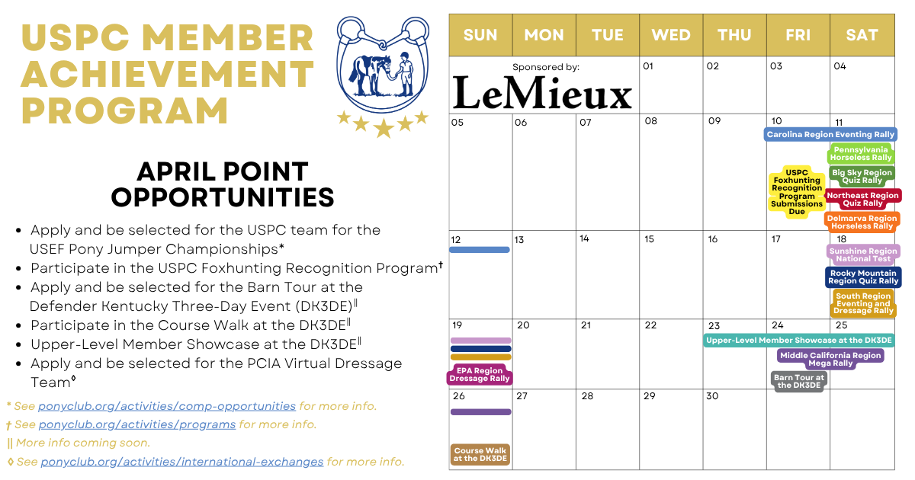

Member Achievement Program
USPC Member Achievement Program
ANNOUNCING POINTS
Look for announcements about the program on our social media channels.

Slide 9

Member Achievement Program
USPC Member Achievement Program
ANNOUNCING POINTS
Watch for the star graphics on USPC announcements to see how many points you can earn for a particular activity.
25
OR
50
MEMBER ACHIEVEMENT PROGRAM
ACHIEVE
POINT ELIGIBLE

Slide 10
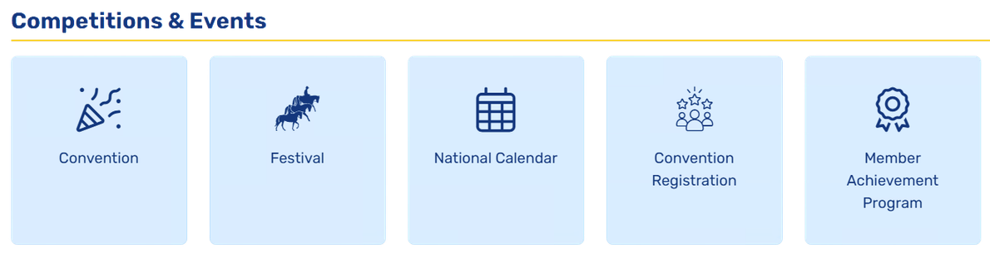
Member Achievement Program
USPC Member Achievement Program
REGISTRATION
  Log into ponyclub.org.
  From your profile, under the Competitions & Events section, click “Member Achievement Program.”
  Click “Register” and complete your purchase.

Slide 11
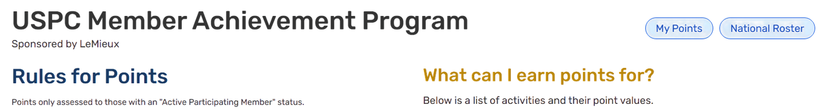
Member Achievement Program
USPC Member Achievement Program
LOG POINTS
  From your profile, under the Competitions & Events section, click “Member Achievement Program.”
  Click “My Points.”

Slide 12
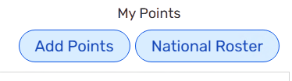
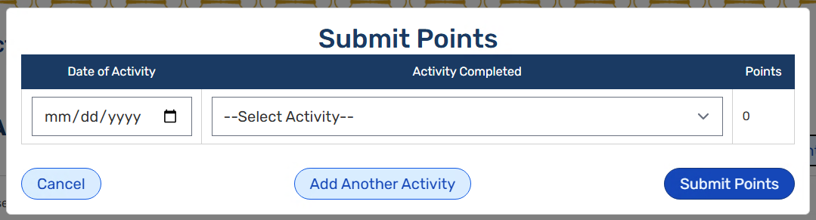
Member Achievement Program
USPC Member Achievement Program
LOG POINTS
  Click “Add Points.”
  Enter the date the points were earned and choose the activity.
  Click “Add Another Activity” to enter another activity.
  Click “Submit Points” to submit your points.

Slide 13
A Big Thank You to LeMieux as the Sponsor
of the USPC Member Achievement Program.
Thank You for Joining Us

